Slide 1


15Cs565
C
Web Security
Cloud Computing

Slide 2
Module-1
Introduction to Web Security

Slide 3
Background
Many sensitive tasks are done through web
Online banking, online shopping
Database access
System administration
Web applications and web users are targets of many attacks
Cross site scripting
SQL injection
Cross site request forgery
Information leakage
Session hijacking

Slide 4

Introduction
Web application security is a branch of Information Security that deals specifically with security of websites, web applications and web services.
At a high level, Web application security draws on the principles of application security but applies them specifically to Internet and Web systems.
Process of securing confidential data stored online from unauthorized access and modification.
Main goal of Web Security to prevent, Detect, and respond.

Slide 5
Web Browser and Network
Network
Browser
request
Web site
reply
OS
Hardware
Browser sends requests
Web site sends response pages, which may include code
Interaction susceptible to network attacks

Slide 6
What is a “Secure” Computer System?
To decide whether a computer system is “secure”, you must first decide what “secure” means to you, then identify the threats you care about.
You Will Never Own a Perfectly Secure System!
Threats - examples
Viruses, trojan horses, etc.
Denial of Service
Stolen Customer Data
Modified Databases
Identity Theft and other threats to personal privacy
Equipment Theft
Espionage in cyberspace
Hack-tivism
Cyberterrorism
…

Slide 7
Basic Components of Security: Confidentiality, Integrity, Availability (CIA)
CIA
Confidentiality: Who is authorized to use data?
Integrity: Is data „good?”
Availability: Can access data whenever need it?
C
I
S
A
CIA or CIAAAN… ☺
(other security components added to CIA)
Authentication
Authorization
Non-repudiation
…
S = Secure

Slide 8
Need to Balance CIA
Example 1: C vs. I+A
Disconnect computer from Internet to increase confidentiality
Availability suffers, integrity suffers due to lost updates
Example 2: I vs. C+A
Have extensive data checks by different people/systems to increase integrity
Confidentiality suffers as more people see data, availability suffers due to locks on data under verification)
Notes:
In addition to all the rules and regulations, policies and procedures and the related system specific documentation, there are some current computer security issues of which you as the Executive should be made aware.

Slide 9
Confidentiality
“Need to know” basis for data access
How do we know who needs what data?
Approach: access control specifies who can access what
How do we know a user is the person she claims to be?
Need her identity and need to verify this identity
Approach: identification and authentication
Analogously: “Need to access/use” basis for physical assets
E.g., access to a computer room, use of a desktop

Slide 10
Integrity
Integrity vs. Confidentiality
Concerned with unauthorized modification of assets (= resources)
Confidentiality - concered with access to assets
Integrity is more difficult to measure than confidentiality
Not binary – degrees of integrity
Context-dependent - means different things in different contexts
Could mean any subset of these asset properties:
{ precision / accuracy / currency / consistency /
meaningfulness / usefulness / ...}
Types of integrity—an example
Quote from a politician
Preserve the quote (data integrity) but misattribute (origin integrity)

Slide 11
Availability (1)
Not understood very well yet
„[F]ull implementation of availability is security’s next challenge”
E.g. Full implemenation of availability for Internet users (with ensuring security)
Complex
Context-dependent
Could mean any subset of these asset (data or service) properties :
{ usefulness / sufficient capacity /
progressing at a proper pace /
completed in an acceptable period of time / ...}

Slide 12
Availability (2)
We can say that an asset (resource) is available if:
Timely request response
Fair allocation of resources (no starvation!)
Fault tolerant (no total breakdown)
Easy to use in the intended way
Provides controlled concurrency (concurrency control, deadlock control, ...)

Slide 13
4. Vulnerabilities, Threats, and Controls
Understanding Vulnerabilities, Threats, and Controls
Vulnerability = a weakness in a security system
Threat = circumstances that have a potential to cause harm
Controls = means and ways to block a threat, which tries to exploit one or more vulnerabilities
Most of the class discusses various controls and their effectiveness
[Pfleeger & Pfleeger]
Example - New Orleans disaster (Hurricane Katrina)
Q: What were city vulnerabilities, threats, and controls?
A: Vulnerabilities: location below water level, geographical location in hurricane area, …
Threats: hurricane, dam damage, terrorist attack, …
Controls: dams and other civil infrastructures, emergency response plan, …

Slide 14
Attack (materialization of a vulnerability/threat combination)
= exploitation of one or more vulnerabilities by a threat; tries to defeat controls
Attack may be:
Successful (a.k.a. an exploit)
resulting in a breach of security, a system penetration, etc.
Unsuccessful
when controls block a threat trying to exploit a vulnerability
[Pfleeger & Pfleeger]

Slide 15
Kinds of Threats
Kinds of threats:
Interception
an unauthorized party (human or not) gains access to an asset
Interruption
an asset becomes lost, unavailable, or unusable
Modification
an unauthorized party changes the state of an asset
Fabrication
an unauthorized party counterfeits an asset
[Pfleeger & Pfleeger]

Slide 16
Levels of Vulnerabilities / Threats
D) for other assets (resources)
including. people using data, s/w, h/w
C) for data
„on top” of s/w, since used by s/w
B) for software
„on top” of h/w, since run on h/w
A) for hardware
[Pfleeger & Pfleeger]

Slide 17
Web Security/Privacy Issues
Secure communications between client & server
HTTPS (HTTP over Secure Socket Layer)
User authentication & session management
Cookies & other methods
Active contents from different websites
Protecting resources maintained by browsers
Web application security
Web site authentication (e.g., anti-phishing)
Privacy concerns

Slide 18
HTTP: HyperText Transfer Protocol
Browser sends HTTP requests to the server
Methods: GET, POST, HEAD, …
GET: to retrieve a resource (html, image, script, css,…)
POST: to submit a form (login, register, …)
HEAD
Server replies with a HTTP response
Stateless request/response protocol
Each request is independent of previous requests
Statelessness has a significant impact on design and implementation of applications

Slide 19
Use Cookies to Store State Info
Cookies
A cookie is a name/value pair created by a website to store information on your computer
Http is stateless protocol; cookies add state
Enters form data
Server
Browser
Response + cookies
Request + cookies
Server
Browser
Returns data

Slide 20
Cookies Fields
An example cookie from my browser
Name session-token
Content "s7yZiOvFm4YymG….”
Domain .amazon.com
Path /
Send For Any type of connection
Expires Monday, September 08, 2031 7:19:41 PM

Slide 21
Cookies
Stored by the browser
Used by the web applications
used for authenticating, tracking, and maintaining specific information about users
e.g., site preferences, contents of shopping carts
data may be sensitive
may be used to gather information about specific users
Cookie ownership
Once a cookie is saved on your computer, only the website that created the cookie can read it

Slide 22
Web Authentication via Cookies
HTTP is stateless
How does the server recognize a user who has signed in?
Servers can use cookies to store state on client
After client successfully authenticates, server computes an authenticator and gives it to browser in a cookie
Client cannot forge authenticator on his own (session id)
With each request, browser presents the cookie
Server verifies the authenticator

Slide 23


A Typical Session with Cookies
client
server
POST /login.cgi
Verify that this
client is authorized
Set-Cookie:authenticator
GET /restricted.html
Cookie:authenticator
Check validity of
authenticator
Restricted content
Authenticators must be unforgeable and tamper-proof
(malicious clients shouldn’t be able to modify an existing authenticator)
How to design it?
Notes:
What should the authenticator depends upon?
User name, current time

Slide 24
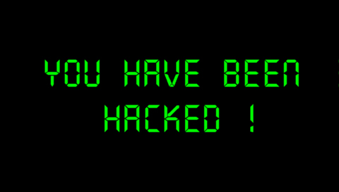
Security threats
With the emergence of Web, increased information sharing through social networking and increasing business adoption of the Web as a means of doing business and delivering service, websites are often attacked directly.
Hackers either seek to compromise the corporate network or the end-users accessing the website by subjecting them to drive-by downloading.

Slide 25
Security Threats (2)
Industry is paying increased attention to the security of the web applications themselves in addition to the security of the underlying computer network and operating systems.
The majority of web application attacks occur through cross-site scripting (XSS) and SQL injection attacks which typically result from flawed coding, and failure to sanitize input to and output from the web application.
Phishing is another common threat to the Web application and global losses from this type of attack in 2012 were estimated at $1.5 billion.

Slide 26
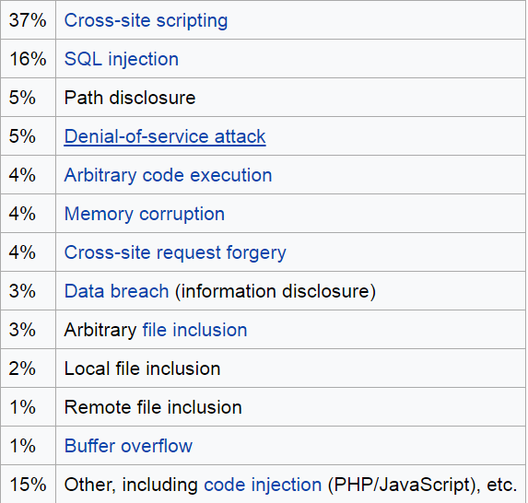
The Top Vulnerabilities

Slide 27
Encoding Scheme
Character Encoding
Image & Audio and Video Encoding

Slide 28
Character Encoding
Character encoding encodes characters into bytes. It informs the computers how to interpret the zero and ones into real characters, numbers, and symbols. The computer understands only binary data; hence it is required to convert these characters into numeric codes.
To achieve this, each character is converted into binary code, and for this, text documents are saved with encoding types.

Slide 29
There are different types of Character Encoding techniques
HTML Encoding
URL Encoding
Unicode Encoding
Base64 Encoding
Hex Encoding
ASCII Encoding

Slide 30
HTML Encoding
HTML encoding is used to display an HTML page in a proper format. With encoding, a web browser gets to know that which character set to be used.
In HTML, there are various characters used in HTML Markup such as <, >. To encode these characters as content, we need to use an encoding.
URL Encoding
URL (Uniform resource locator) Encoding is used to convert characters in such a format that they can be transmitted over the internet. It is also known as percent-encoding. The URL Encoding is performed to send the URL to the internet using the ASCII character-set. Non-ASCII characters are replaced with a %, followed by the hexadecimal digits.

Slide 31
UNICODE Encoding
Unicode is an encoding standard for a universal character set. It allows encoding, represent, and handle the text represented in most of the languages or writing systems that are available worldwide. It provides a code point or number for each character in every supported language. It can represent approximately all the possible characters possible in all the languages. A particular sequence of bits is known as a coding unit.
A UNICODE standard can use 8, 16, or 32 bits to represent the characters.
The Unicode standard defines Unicode Transformation Format (UTF) to encode the code points.

Slide 32
UTF-8 Encoding The UTF8 is defined by the UNICODE standard, which is variable-width character encoding used in Electronics Communication. UTF-8 is capable of encoding all 1,112,064 valid character code points in Unicode using one to four one-byte (8-bit) code units.
UTF-16 Encoding
UTF16 Encoding represents a character's code points using one of two 16-bits integers.
UTF-32 Encoding UTF32 Encoding represents each code point as 32-bit integers.

Slide 33
Base64 Encoding
Base64 Encoding is used to encode binary data into equivalent ASCII Characters. The Base64 encoding is used in the Mail system as mail systems such as SMTP can't work with binary data because they accept ASCII textual data only. It is also used in simple HTTP authentication to encode the credentials.

Slide 34
ASCII Encoding
American Standard Code for Information Interchange (ASCII) is a type of character-encoding. It was the first character encoding standard released in the year 1963.
Th ASCII code is used to represent English characters as numbers, where each letter is assigned with a number from 0 to 127. Most modern character-encoding schemes are based on ASCII, though they support many additional characters. It is a single byte encoding only using the bottom 7 bits. In an ASCII file, each alphabetic, numeric, or special character is represented with a 7-bit binary number. Each character of the keyboard has an equivalent ASCII value.

Slide 35
Image and Audio & Video Encoding
Image and audio & video encoding are performed to save storage space. A media file such as image, audio, and video are encoded to save them in a more efficient and compressed format.
These encoded files contain the same content with usually similar quality, but in compressed size, so that they can be saved within less space, can be transferred easily via mail, or can be downloaded on the system.
. WAV audio file is converted into .MP3 file to reduce the size by 1/10th to its original size.

Slide 36
Outline
Introduction to web application penetration testing
Software setup
Mapping and analyzing the application
Bypassing client-side controls
Attacking authentication
Attacking session management
Attacking data stores

Slide 37
Why the web?
Let’s look at some statistics:
Over 3.9 billion internet users in the world
Over 1.9 billion websites online
We use websites for everything: e-commerce, online banking to social networking, social media, etc.
Web security has become a major concern for businesses.
Recent example: Equifax. The breach exposed the personal information of 143 million US users and an estimated 100,000 Canadian users.
According to Trustwave’s 2018 Global Security Report:
100% of the web applications scanned by Trustwave displayed at least one vulnerability.
Median number of 11 vulnerabilities detected per application.

Slide 38
How to secure a web application?
Combination of techniques are used:
Secure coding practices
Web application firewalls
Static code analysis
Web application penetration testing
Etc.

Slide 39
What is web app pen testing?
Combination of manual and automated tests to identify vulnerabilities, security flaws and/or threats in a web application.
Categorized into three types:
White box: Tester has complete access and in-depth knowledge of the system. Access to source code is usually given.
Black box: Tester is given little to no information about the system. Just the URL of the application is usually given.
Grey box: Combination of white box and black box penetration testing. Limited information and access is given to the tester.
Several methodologies and guidelines: OWASP, PTES, PCI DSS, etc.
Most important thing to keep in mind: you need permission to perform a security test!

Slide 40

What is owasp?
Stands for Open Web Application Security Project
International open source community “dedicated to enabling organizations to conceive, develop, acquire, operate, and maintain applications that can be trusted”.
Contains widely used and popular tools such as the ZAP.
OWASP TOP 10 Project

Slide 41
Abstract pen testing Methodology
Reconnaissance
Mapping + Analyzing
Exploitation
Discovery

Slide 42
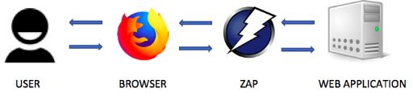
How does a proxy work?
Notes:
Any request sent by the browser will first be intercepted by zap and then sent to the web application. Similarly, any response sent by the web application will be intercepted by zap and then sent to the browser. When a request is intercepted, ZAP can modify the request to exploit an existing vulnerability in the web application.

Slide 43
Mapping the application
Explore the visible content
Review public resources
Identify any hidden content

Slide 44
ANALYZING the application
Identify functionality
Identify data entry points
Identify the technologies used
Map the attack surface

Slide 45
Bypassing Client-Side Controls

Slide 46



Client-Side vs server-side validation
Client-side
Server-side
3
2
3
1
1
2

Slide 47
Bypassing Client-Side Controls
Allowing clients to submit arbitrary input is a core security problem in web applications.
Users have full control of everything submitted from the client.
Can cause a range of problems including corrupting data stores, allowing unauthorized access to users and buffer overflows.
In general, there are two ways client-side controls are used to restrict user input:
Transmitting data via the client using mechanisms that “prevent” user interaction. Examples include hidden form fields, disabled elements, referrer header, URL parameters, etc.
Controlling user input using measures that “restrict” user input. Examples include HTML form features, client-side scripts, etc.

Slide 48
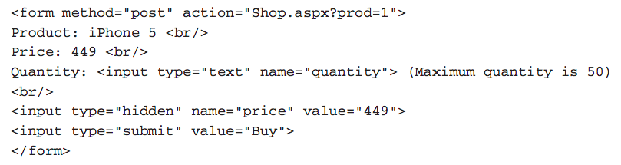
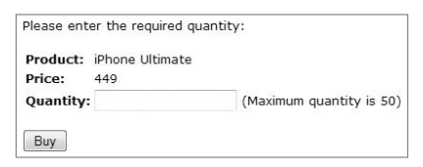
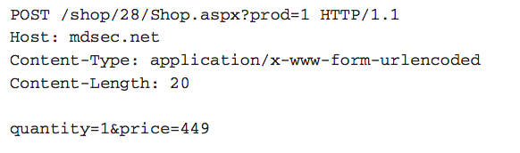
Transmitting data via the client
Example #1: Hidden Form Field
Code
Request

Slide 49
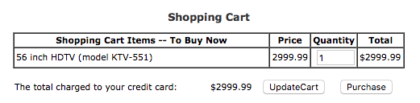
exercise #2: WEBGOAT
Exploit Hidden Fields
Try to purchase the HDTV for less than the purchase price, if you have not done so already.
Notes:
In order to change the price value, click on Purchase button and intercept the request using Burp Proxy. In the intercepted request, you’ll see that the price field is sent to the server as a parameter when the form is submitted. Change the price value to the desired value and forward the request by clicking on the Forward button in Burp. The application will successfully process the transaction with the chosen price value.

Slide 50
authentication
Authentication is a mechanism for validating a user.
There are many authentication technologies:
HTML forms-based authentication
Multifactor authentication
Client SSL certificates and/or smartcards
etc
In general, there are two factors that result in insecure authentication:
Design flaws in authentication mechanisms
Implementation flaws in authentication

Slide 51
Design flaws in authentication mechanisms
Bad passwords*
Brute-forcible logins
Verbose Failure messages
Vulnerable transmission of credentials
Weaknesses in password change functionality
Weaknesses in forgotten password functionality*
etc.

Slide 52
Bad passwords
Very short or blank passwords
Common dictionary words or names
The same as the username
Still set to the default value
Check the strength of your password:
https://password.kaspersky.com/

Slide 53
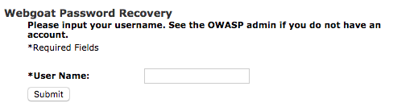
exercise #5: WEBGOAT
Forgot Password
The goal is to retrieve the password of another user.
Notes:
The goal of this exercise is to retrieve the password of another user. We’ll try to get the admin’s password. Try the username ‘admin’, You get directed to another page that contains the secret question which means the username ‘admin’ is a valid username. Now, enter any color in the answer field and intercept the request in Burp Suite. In the Intercept sub-tab of the proxy tab, right click anywhere on the request and select ‘Send to Intruder’. In the ‘Intruder’ tab, click the ‘Clear’ button to clear all payload markers and highlight the color you entered and click the ‘Add’ button. Switch to the ‘Payloads’ sub-tab and add all the colors under ‘Payloads Options [Simple List]’. Make sure that the proxy intercept is off. Switch back to the ‘Positions’ sub-tab and click on ‘Start Attack’. The color with the different payload size is the correct answer (in this case it is green).

Slide 54
IMPLEMENTATION FLAWS IN AUTHENTICATION
Fail-open login mechanisms
Defects in multistage login mechanisms*
Assumption that access to a later stage means that the user cleared prior stages.
Trusting client side data across stages
Insecure storage of credentials
etc.

Slide 55
Attacking session management
Understand the mechanism
Test session tokens for meaning
Test session tokens for predictability
Check for session termination
Altoro Mutual (testfire.net)
Register Account (tutorialsninja.com)

Slide 56
Surprise Test-1
Set-A
Q1. Explain basic components of web security-3M
Q2. List Top 10 Vulnerabilities in web security-3M
Q3.With suitable example, explain white list validation.-4M
Set-B
Q1.Discuss any three web encoding schemes-3M
Q2. List and explain the design and implementation flaws in authentication-3M
Q3. With suitable example , explain blacklist validation.-4M

